Slide 1
Workshop: Kubernetes 101 (Part 1 & 2)
Kubernetes Community Days Chennai 3 June 2022

Slide 2
Agenda
Container Orchestration and its benefits
Kubernetes Architecture
Cloud/Managed Services
On-Premise/Self Hosted
Setting up your first Kubernetes Cluster using K3D
Basic Kubectl Commands
Q&A
Workshop URL: https://kcdchennai.github.io/cloudnative-k8s-workshop/
GitHub: https://github.com/kcdchennai/cloudnative-k8s-workshop

Slide 3
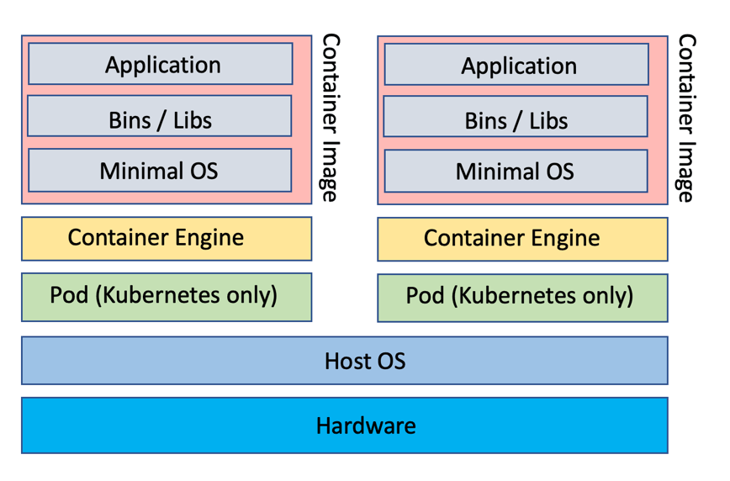
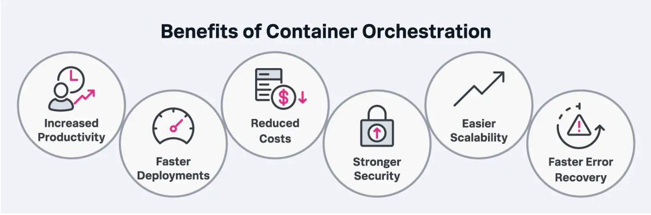
Introduction to Container Orchestration & Kubernetes
Container Orchestration and its benefits
- What are Container and Why do we need them..?
- What is Container Orchestration - https://kubernetes.io/docs/concepts/overview/what-is-kubernetes/
Notes:
https://cloud.google.com/learn/what-are-containers
https://www.redhat.com/en/topics/containers/what-is-container-orchestration

Slide 4
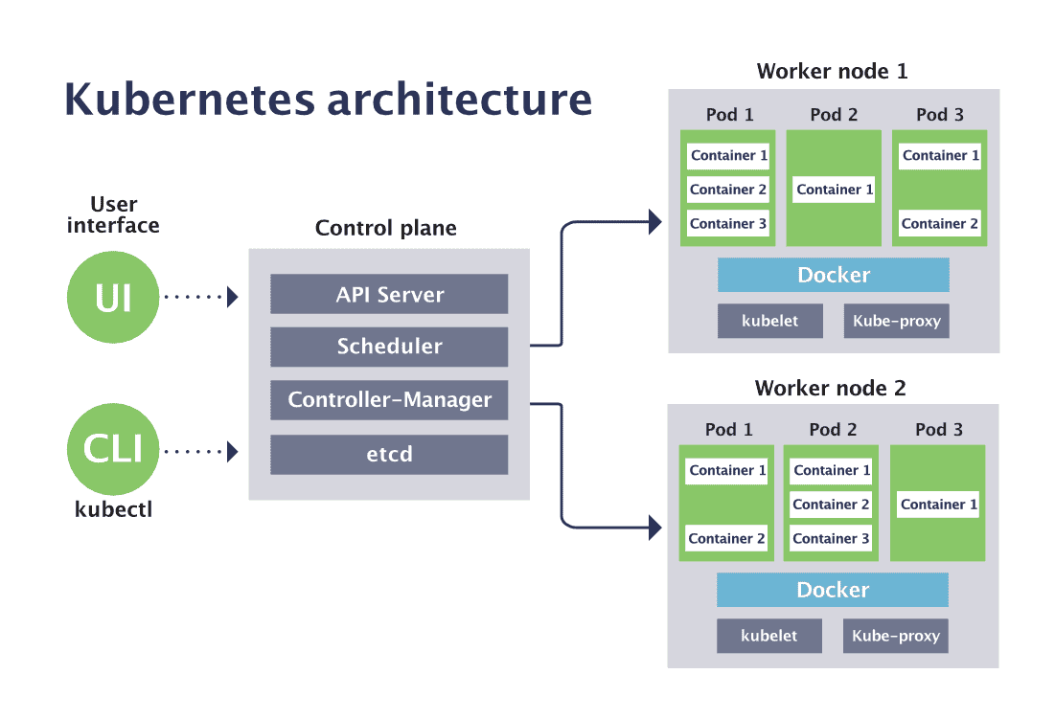
Introduction to Container Orchestration & Kubernetes
Kubernetes Architecture
- Kubernetes Architecture - https://kodekloud.com/kubernetes-architecture-overview-for-devops-enthusiasts/
- Kubernetes Components - https://kubernetes.io/docs/concepts/overview/components/
- Whats is a Pod ?

Slide 5
Setting up your first Kubernetes Cluster
Cloud/Managed Services
1. Elastic Kubernetes Service (EKS) – Amazon 2. Azure Kubernetes Service (AKS) – Microsoft 3. Google Kubernetes Engine (GKE) – Google
On-Premise/Self Hosted
Kubeadm (https://kubernetes.io/docs/setup/production-environment/tools/kubeadm/create-cluster-kubeadm/)
Kops (https://github.com/kubernetes/kops)
Minikube (https://minikube.sigs.k8s.io/docs/start/)
K3d (https://k3d.io/)
Kind (https://kind.sigs.k8s.io/)

Slide 6
Setting up your first Kubernetes Cluster using K3D
Pre-requisites
1. WSL 2.0 (Windows 10 2004 or Later)
2. Linux
Deploy Kubernetes
1. Preparation/Base Setup (WSL/Docker Setup)
2. Install K3D
3. Deploy a multi-node Kubernetes cluster with K3D
4. Cluster access and administration

Slide 7
Basic Kubectl Commands
- What is Kubectl..? - https://kubernetes.io/docs/tasks/tools/
- Control Plane & Worker Node Components
- List & Describe Pods, Pod Logs
https://kubernetes.io/docs/reference/kubectl/cheatsheet/
Notes:
https://kubernetes.io/docs/setup/production-environment/container-runtimes/
https://kubernetes.io/docs/tasks/tools/#:~:text=The%20Kubernetes%20command%2Dline%20tool,cluster%20resources%2C%20and%20view%20logs.

Slide 8


Slide 9
Workshop: Kubernetes 101 (Part 3 & 4)
Kubernetes Community Days Chennai 3 June 2022

Slide 10
Agenda
Scaling & Deploying Applications
Services and Port-forwarding
Deploy Cloud-Native Application on K8s Cluster
Observability - Metrics, Logging & Troubleshooting
Q&A
Workshop URL: https://kcdchennai.github.io/cloudnative-k8s-workshop/
GitHub: https://github.com/kcdchennai/cloudnative-k8s-workshop

Slide 11
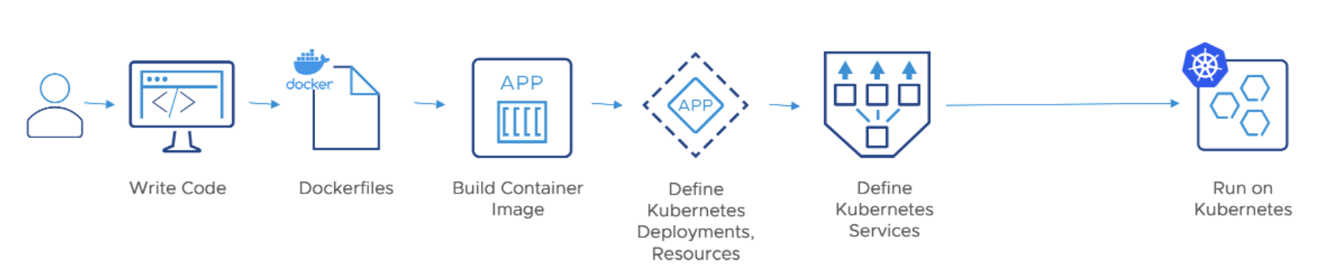
Scaling and Deploying Applications
Notes:
https://medium.com/stakater/k8s-deployments-vs-statefulsets-vs-daemonsets-60582f0c62d4
https://medium.com/avmconsulting-blog/service-types-in-kubernetes-24a1587677d6

Slide 12
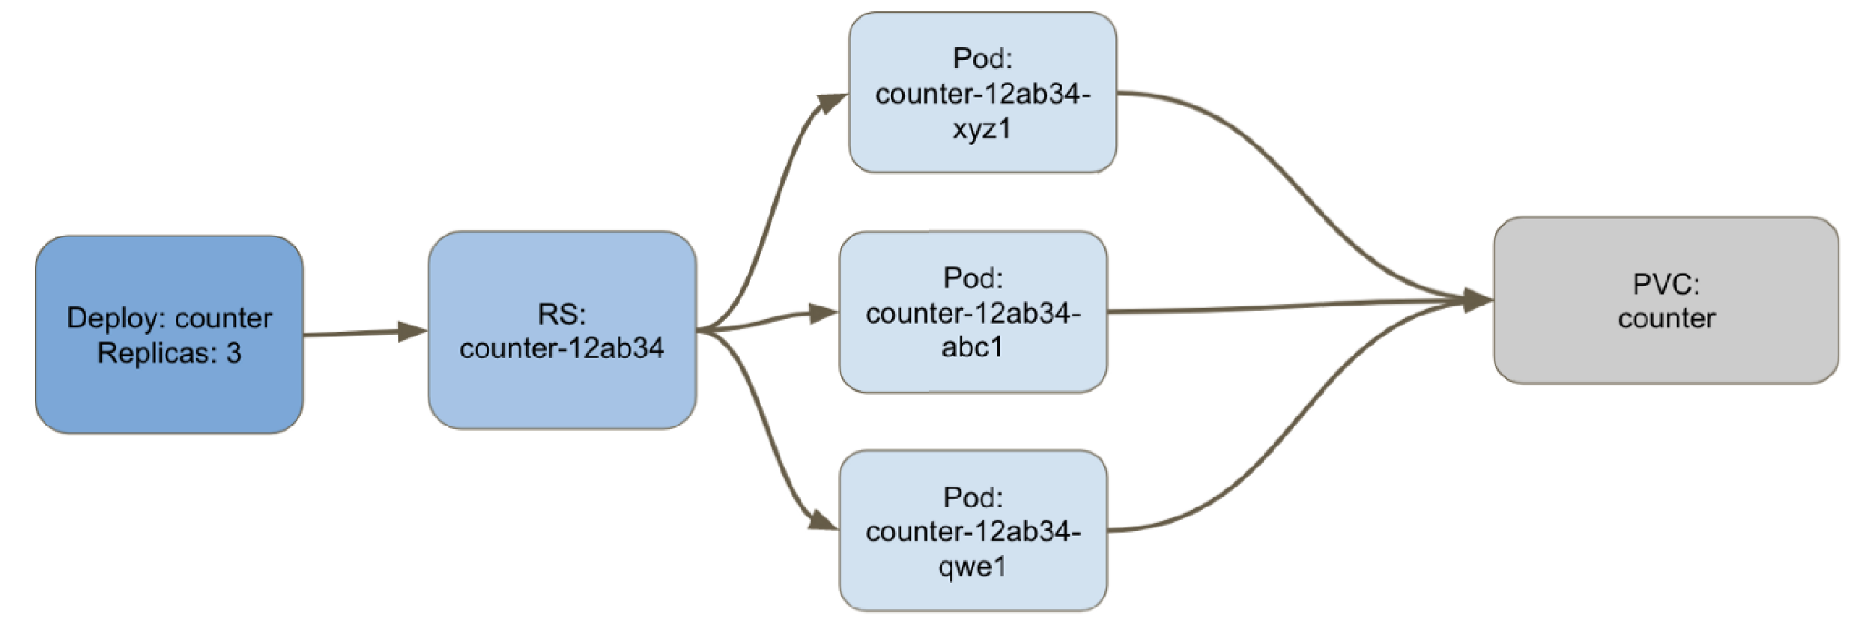
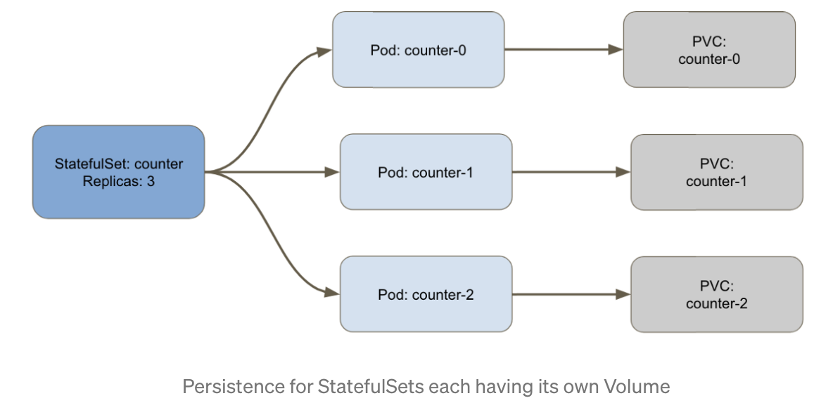
Scaling and Deploying Applications
Pod Controllers
- Controller Options - https://kubernetes.io/docs/concepts/workloads/controllers/
Deployment: Statefulset:
Notes:
https://medium.com/stakater/k8s-deployments-vs-statefulsets-vs-daemonsets-60582f0c62d4
https://medium.com/avmconsulting-blog/service-types-in-kubernetes-24a1587677d6

Slide 13
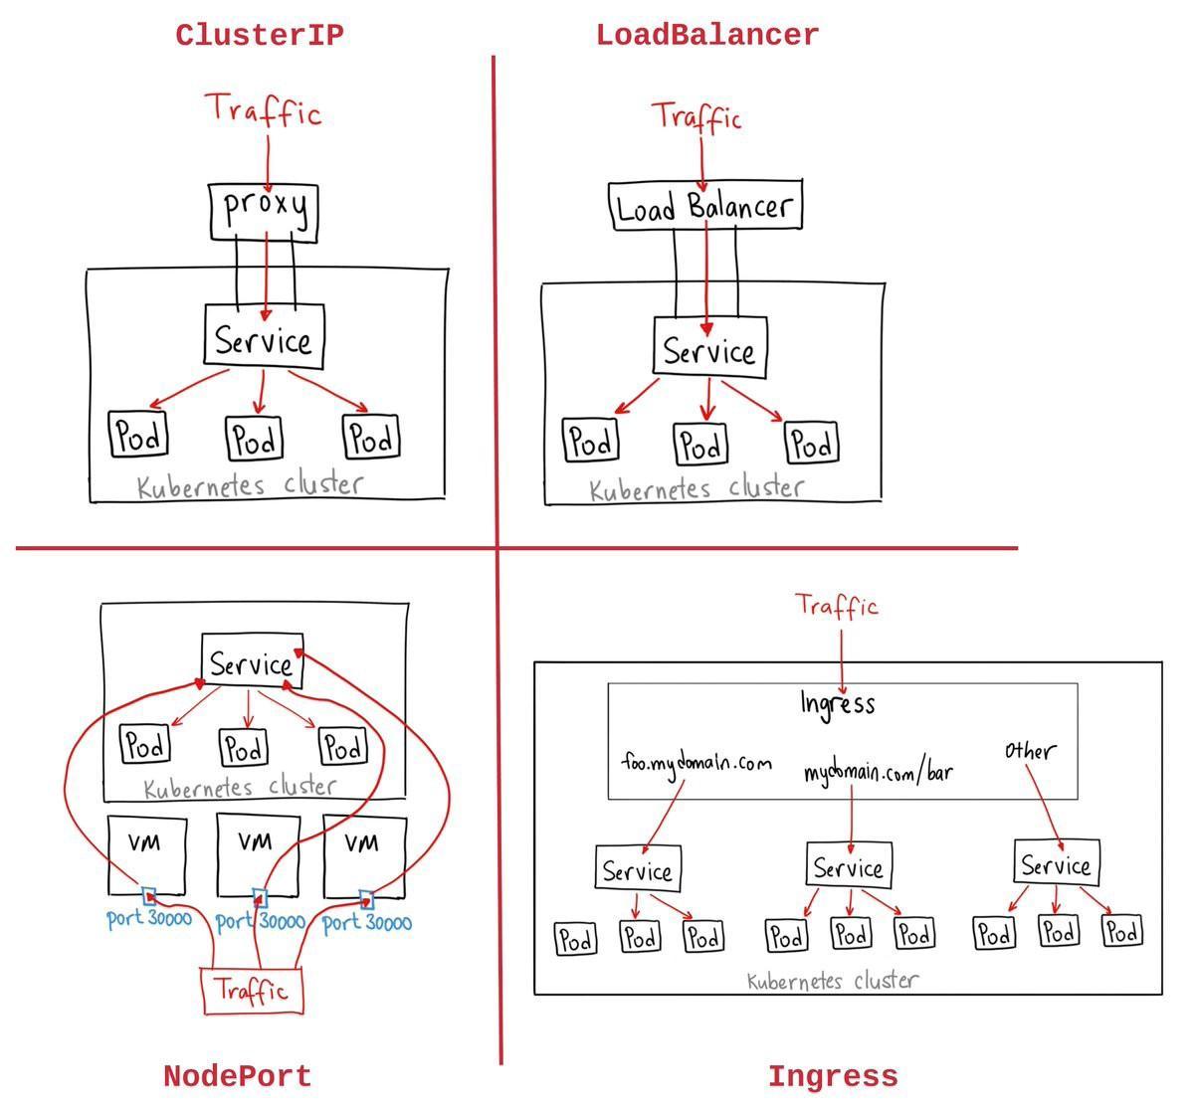
Scaling and Deploying Applications
Services & Port forwarding
- Services & Types - https://kubernetes.io/docs/concepts/services-networking/service/
- Ingress & Ingress Controller - https://kubernetes.io/docs/concepts/services-networking/ingress/
- Port-Forwarding - https://kubernetes.io/docs/tasks/access-application-cluster/port-forward-access-application-cluster/
Notes:
https://medium.com/stakater/k8s-deployments-vs-statefulsets-vs-daemonsets-60582f0c62d4
https://medium.com/avmconsulting-blog/service-types-in-kubernetes-24a1587677d6

Slide 14
Deploying a cloud-native application in K8s cluster
Running Container on Kubernetes
- Introduction to Pod and Manifests
- Different Pod States and Probes
- Live Lab
Workshop
- Quick introduction to sample application
- Image build and setup
- Create a deployment and service
- Create an ingress for outside world access

Slide 15
Observability: Metrics, Logging & Troubleshooting
Metrics
- Metrics Server - https://kubernetes.io/docs/tasks/debug/debug-cluster/resource-metrics-pipeline
- Prometheus & Grafana - https://prometheus.io/docs/introduction/overview/
Logging
- Application Logging - https://kubernetes.io/docs/concepts/cluster-administration/logging/
- ELK Stack - https://www.elastic.co/what-is/elk-stack
Troubleshooting
- Troubleshooting Applications - https://kubernetes.io/docs/tasks/debug/debug-application/
- Troubleshooting Clusters - https://kubernetes.io/docs/tasks/debug/debug-cluster/
Notes:
https://opensource.com/article/21/6/chaos-grafana-prometheus
https://www.javainuse.com/spring/springboot-microservice-elk

Slide 17
Thank you

